Slide 1

Adventure Works Cycle Sales Analysis

Slide 2
SUMMARY
The Adventure Works Sales Dashboard provides a comprehensive analysis of the company's sales, profit, customers, products, production costs, and regional performance.
The business achieved total sales of approximately $29.36 million and total profit of $12.08 million, with a strong profit margin of 41.15%. The analysis shows that 2013 was the strongest sales year, while Q4 and December recorded the highest quarterly and monthly sales respectively.
Mountain-200 products were among the strongest profit generators, and Black-colored products generated the highest profit by color. The 50+ customer segment contributed the largest share of profit, highlighting an important target market.
Overall, the dashboard helps management identify profitable products, valuable customers, seasonal trends, and regional opportunities, enabling more informed decisions regarding marketing, inventory, customer retention, and business growth.

Slide 3
KPI( KEY PERFORMANCE INDICATOR)
Year-wise Sales
Month-wise Sales
Quarter-wise Sales
Product-wise Sales
Customer-wise Sales
Top 10 Products by Profit
Top 10 Customers by Profit
Sales by Region/Country
Sales Amount vs Production Cost
Profit by Age Group
Profit by Color
Top Products by Profit Margin
Sales by Product Category

Slide 4
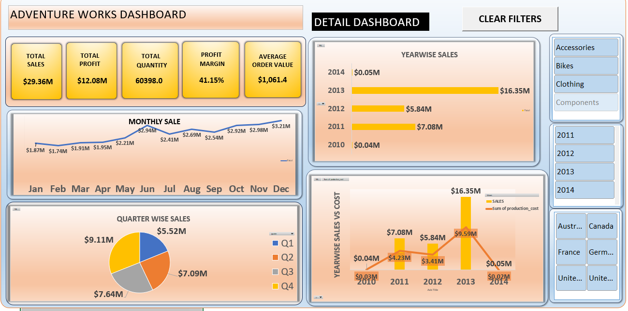
EXCEL DASHBOARD

Slide 5
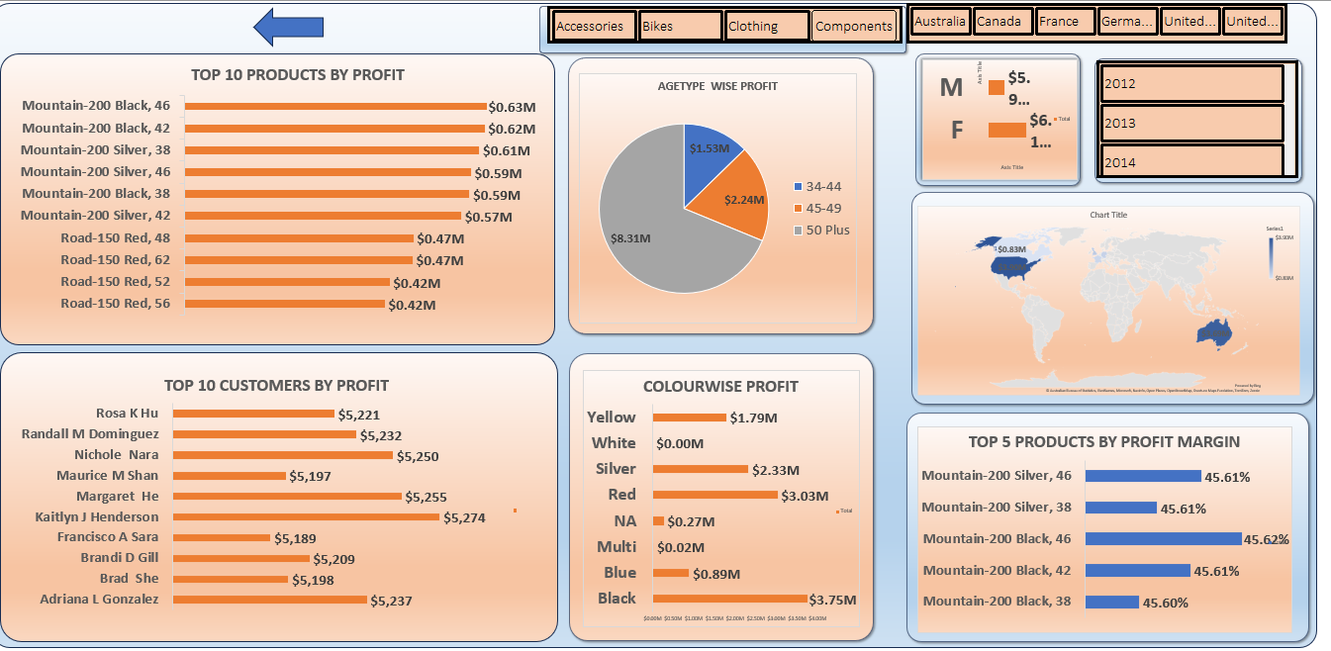

Slide 6
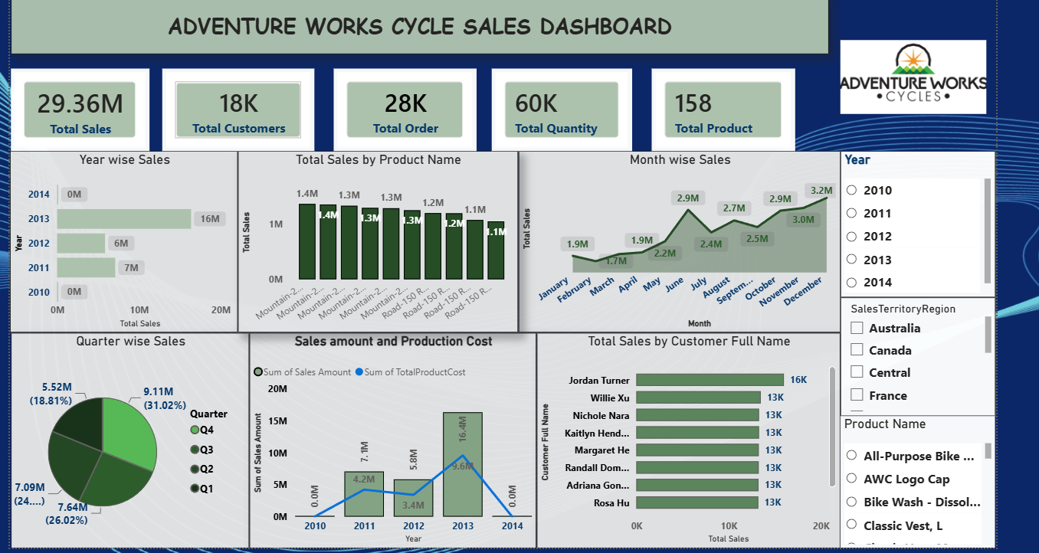
POWER BI Dashboard

Slide 7
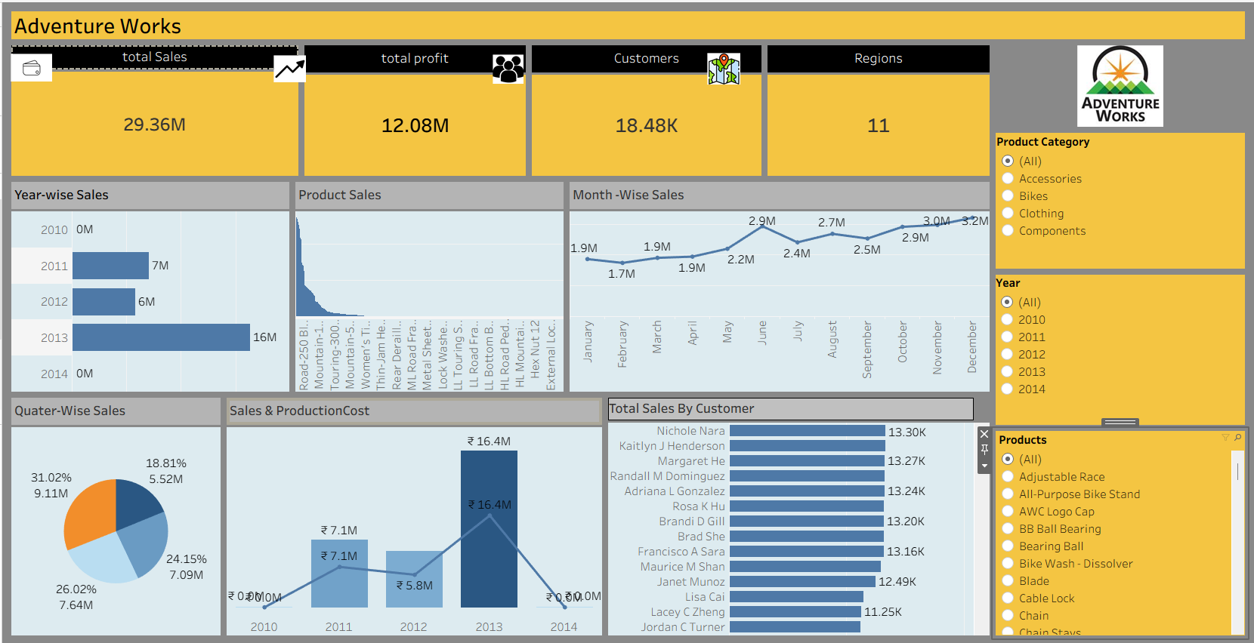
Tableau Dashboard

Slide 8
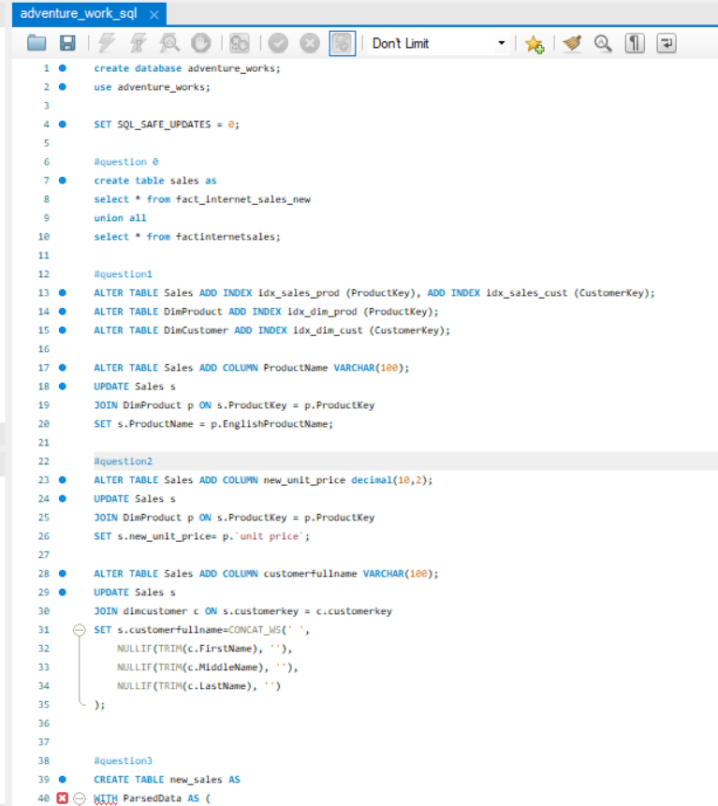
My SQL Script FILE

Slide 9
KEY LEARNING OUTCOMES
The Adventure Works Cycle Sales Dashboard provides a comprehensive view of sales performance, profitability, customers, products, regions, and production costs. The dashboards show total sales of approximately $29.36M, total profit of $12.08M, around 18K customers, 60K total quantity, and a profit margin of approximately 41.15%.
The year-wise analysis shows that 2013 was the strongest-performing year, generating approximately $16.35M in sales, while 2010 and 2014 contributed very little. This indicates that sales performance is highly concentrated in 2013. The monthly trend shows strong growth from January to December, with December reaching around $3.21M, indicating increasing demand toward the end of the year.
The product analysis highlights Mountain-200 and Road-150 product categories among the top-performing products by profit. These products should receive greater attention in inventory planning and marketing campaigns. Customer analysis also identifies high-value customers, which can help the company develop loyalty programs and personalized offers.
The Sales vs Production Cost analysis shows that sales are significantly higher than production costs in the major years, particularly 2013, indicating strong profitability. However, production costs should continue to be monitored to protect margins.
Project Suggestions
Focus marketing and inventory strategies on high-profit products.
Develop loyalty programs for high-value customers.
Increase promotional activities during high-performing months.
Analyze low-performing years and regions to identify improvement opportunities.
Monitor production costs regularly to maintain the current profit margin.
Add KPI cards for Sales Growth %, Profit Growth %, and Cost % of Sales.
Include interactive drill-through pages for Product, Customer, and Region analysis.
Add forecasting to predict future sales and demand.

Slide 10
BUSINESS RECOMMENDATION
The Adventure Works analysis shows a strong and profitable business with $29.36M in total sales and $12.08M in profit. The analysis identifies 2013 as the strongest sales year and Q4 as the highest-performing quarter.
Mountain-200 products are among the key profit contributors, while customers aged 50+ represent the most valuable customer segment.
The dashboard enables management to identify sales trends, control production costs, focus on high-performing products and customers, and make data-driven decisions regarding marketing, inventory and business growth.

Slide 11

THANK YOU

